Slide 1
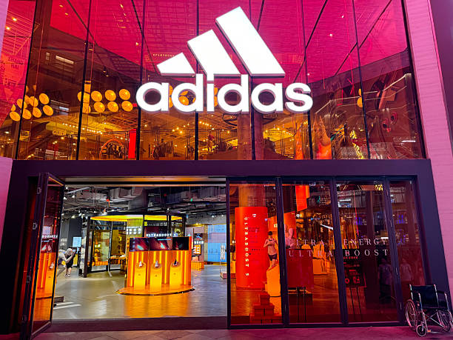
Adidas Sales Analysis

Slide 2
Introduction
This report provides a comprehensive overview of Adidas sales performance, examining revenue, product categories, sales channels, and regional contributions. The analysis highlights year-on-year growth, key product drivers, and sales methods, offering actionable recommendations to strengthen profitability and sustain growth.

Slide 3
Tools Justification
Although the task suggested using Python libraries (Matplotlib, Seaborn, etc.), this analysis was performed in Power BI. The choice was based on two reasons:
1. Skill Level: At the time of the project, Python for visualization had not yet been covered in my learning path, while I had practical experience with Excel and Power BI.
2. Business Relevance: Power BI is widely used in organizations for interactive dashboards, KPI tracking, and storytelling with data, making it a suitable tool for delivering insights to non-technical stakeholders.
This approach ensured that the project outcomes remained aligned with the objectives: transforming raw data into meaningful insights and actionable recommendations , even though a different tool was applied.

Slide 4
Key Highlights
Total Sales: $899.90M
Units Sold: ~2M
Operating Profit: $332.13M
Average Margin: 0.42
YoY Sales Growth: 394.23% (from $182.08M in 2020 to $717.82M in 2021)
👉 Adidas experienced exceptional growth in 2021, reflecting successful campaigns, stronger channel penetration, and market expansion.

Slide 5
Main Sales Overview
Total Sales: $899.90M | Units Sold: ~2M | Profit: $332.13M|YoY Growth: 394% (2020 → 2021)
Sales by Method: Online ($356.6M) > Outlet ($295.6M) > In-store ($247.7M)
Top Products:
Men’s Street Footwear ($209M)
Women’s Apparel ($179M)
Regional Leader: West ($269.9M)
👉 Insight: Online and Men’s Footwear drive sales, with West region dominating.

Slide 6
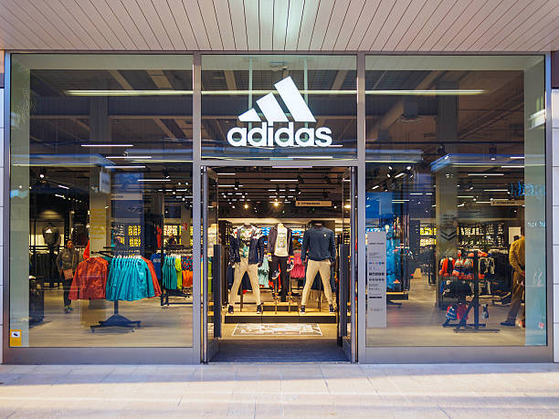
Regional & Retailer Insights
Top Regions: West ($269.9M), Northeast ($186.3M)
Top States: New York ($64M), California ($60M), Florida ($59M)
Top Retailers by Sales:
West Gear ($242.9M)
Foot Locker ($220.1M)
Sports Direct ($182.5M)
👉 Profitability: West Gear & Foot Locker strongest, Amazon & Walmart lag.
Insight : Sales are concentrated in specialty retailers and strong states like NY & CA.

Slide 7
Sales & Profit Analysis
Product Leaders:
Women’s Apparel & Footwear also significant.
Profitability by Retailer:
West Gear ($85.6M), Foot Locker ($80.7M), Sports Direct ($74.3M).
Margin Trend: Slight improvement (0.404 → 0.426).
👉 Insight: Footwear is Adidas’ profit backbone; margins improving steadily.

Slide 8
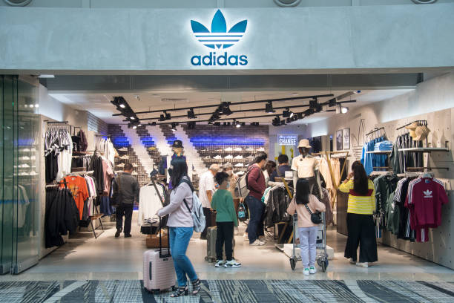
Sales Method & Channel Effectiveness
Sales by Method: In-store ($356.6M), Outlet ($295.6M), Online ($247.7M).
Profitability by Method: In-store ($127.6M) > Outlet ($108M) > Online ($96.6M).
Sales Over Time: Online grew fastest (from $4.8M in 2020 to $262.7M in 2021).
Units Sold: Online (939K), Outlet (850K), In-store (690K).
👉 Insight: Online drives volume but margins are stronger in-store.

Slide 9
Recommendations
1. Optimize Online Sales Profitability
Reduce logistics and fulfillment costs.
Introduce premium digital-exclusive products to improve margins.
2. Regional Expansion
Develop targeted campaigns in Midwest and South to close the gap with the West.
Partner with regional influencers and local stores for market penetration.
3. Product Strategy
Continue investing in Men’s Street Footwear, the strongest revenue driver.
Strengthen Women’s Apparel & Footwear to balance the portfolio.
4. Channel Balance
Leverage in-store and outlet for higher-margin sales.
Use online for volume growth, but align promotions with profitability.
5. Retailer Partnerships
Deepen relationships with West Gear and Foot Locker through exclusives.
Rethink online strategies with Amazon and Walmart for better returns.

Slide 10
Conclusion
The Adidas Sales Analysis shows an impressive surge in growth, led by online sales, footwear dominance, and strong West region performance. However, sustaining profitability requires a balance between digital expansion and margin optimization. By strengthening regional presence, optimizing product strategies, and deepening profitable retailer partnerships, Adidas can continue its strong growth trajectory while ensuring long-term profitability.

